Slide 1
Up-skilling construction workers in wood construction methods for energy efficient buildings
Upwood Project

Slide 2
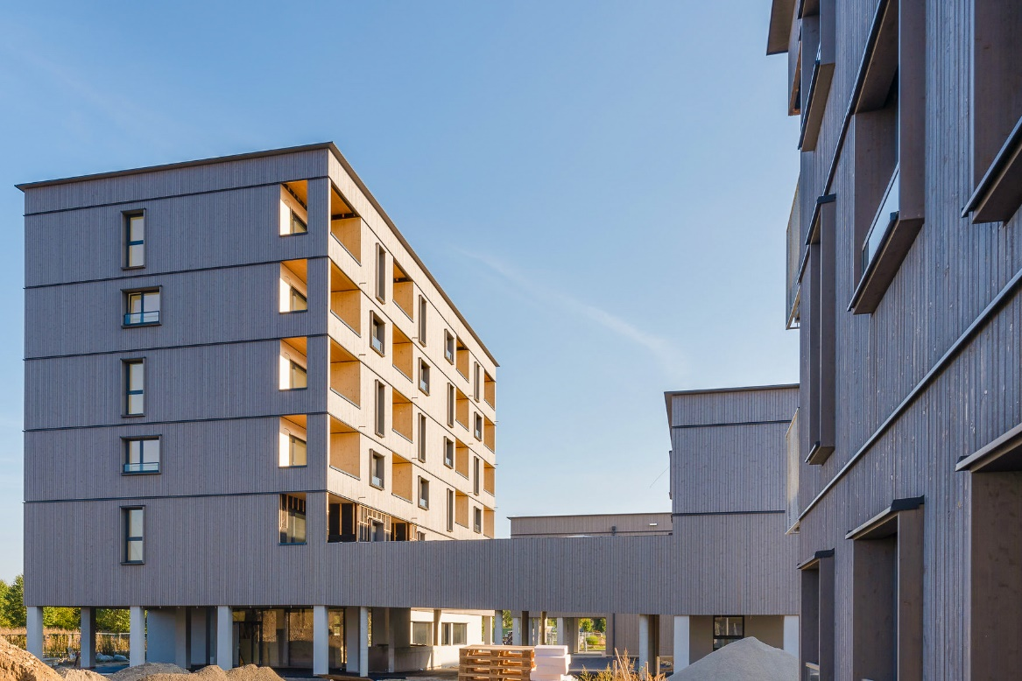
Project aim
UPWOOD forms a Strategic Partnership improve work-based learning VET, by developing and making available educational resources to address current and emerging occupational skills needs for energy efficient and innovative woodworking construction practices.
Project duration: October 2019 - March 2022
Duration: 30 months
©Pierer/WOHNBAUGRUPPE ENNSTAL

Slide 3
OBJECTIVES
Develop new training content on energy efficient wood construction methods and applications.
Develop teaching materials, VET integration guidelines, and trainer’s guide to support VET providers to integrate new woodworking technologies and processes into their WBL and apprenticeships offerings.
Improve cooperation between VET providers and businesses to provide opportunities that will enable learners to apply the acquired knowledge and skills in real-life workplace situations.
1
2
3

Slide 4
MAIN TARGET GROUPS
Construction sector employers
VET & WBL Apprentices in construction sector
Sector representatives and policy makers
VET & WBL providers
Associations, Networks & Social partners
VET authorities & career guidance bodies

Slide 5
PARTNERS
Holzcluster Steiermark
Leading cluster in Graz, developing and implementing projects along the Wood value chains, with special focus on timber construction.
EXELIA
Creative learning solutions company based in Athens, Greece specializing in vocational training with innovative methodologies.
LVT
Prestigious technical education school in Latvia, provides professional education programs, including construction and woodworking.
Universitat Politècnica de València
Public academic institution dedicated to researching and teaching in the field of construction technologies.
Woodpolis
Expert organization providing training and product development services for Wood construction, located in Finland.

Slide 6
MAIN OUTPUTS (1/2)
O1 UPWOOD work-based learning outcomes
Analysis of current and future skills and knowledge needs leading to the development of learning outcomes.
O2 UPWOOD learning units and Open Educational Resources
Development of the structure of a curriculum on innovative, energy efficient woodworking technologies, methods, and practical applications.
Creation of corresponding pedagogical materials to be offered as Open Education Resources.

Slide 7
MAIN OUTPUTS (2/2)
O3 Online training scenarios
Development, testing, and delivery of Online Training Scenarios on woodworking in construction, promoting the uptake of innovative and flexible practices in VET.
O4 Framework for the integration of environmental components into construction sector WBL curricula and certification schemes
Involvement of key policy makers & stakeholders for the recognition of UPWOOD learning outcomes as well for supporting the integration of construction woodworking skills into occupational standards.

Slide 8
EXPECTED RESULTS
Learning materials for training provision in innovative and energy efficient woodworking technologies, methods, and applications in construction for current and future construction workers.
National information day in each partnership country to promote Project results and set an open discussion on increasing the quality and effectiveness of VET provision.
A position paper to support decision-making and promote the incorporation of woodworking in construction skills requirements into the European e-Competence Framework.
A Certificate Supplement for the integration of woodworking in construction skills into certification schemes.

Slide 9
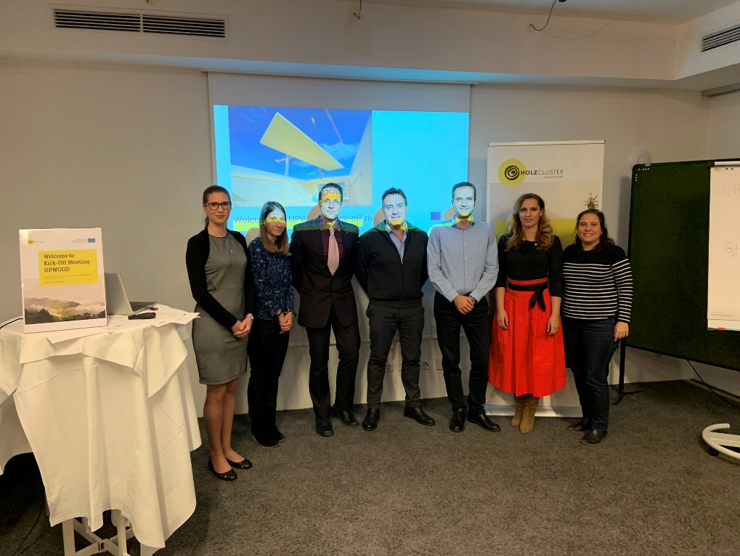
KICK-OFF MEETING
The UPWOOD kick-off meeting was organized by the project Coordinator Holzcluster Steiermark in Graz, Austria, on 12th November 2019.
Partners discussed their roles and outlined the activities as well as project management tasks to be carried out throughout the project. Particular focus & discussion was given to the 1st semester tasks.
Tasks foreseen for the development of Intellectual Output O1 were addressed.
UPWOOD Kick-off meeting
Graz, Austria, 12 November 2019

Slide 10
ACTIVITY PROGRESS
O1 UPWOOD work-based learning outcomes
During the first months of the project and based on the methodology developed by EXELIA with the contribution of all partners, an online survey was developed in order to identify the set of skills, knowledge and competencies required by construction sector WBL learners to perform energy efficient woodworking applications and methods.
Additionally, partners carried out desk research on the relevant construction sector apprenticeships in their own country, to identify trends in skill supply.
The UPWOOD learning outcomes report is being developed based on the collected input.

Slide 11
CONTACT US: upwood2019@gmail.com
Project coordinator: Austria
Mag. Visnja Koscak
Holzcluster Steiermark GmbH
T +043 (0) 316-58 78 50 - 220
Follow us:
www.upwoodproject.eu
Koscak@holzcluster-steiermark.at
DISCLAIMER: “The European Union support for the production of this publication does not constitute an endorsement of the content which reflects the views only of the authors, and the Commissions cannot be held responsible for any use which may be made of the information held therein.”

