Slide 1
Up-skilling construction workers in wood construction methods for energy efficient buildings
Upwood Project
3rd Semester overview & progress October 2020 - March 2021

Slide 2
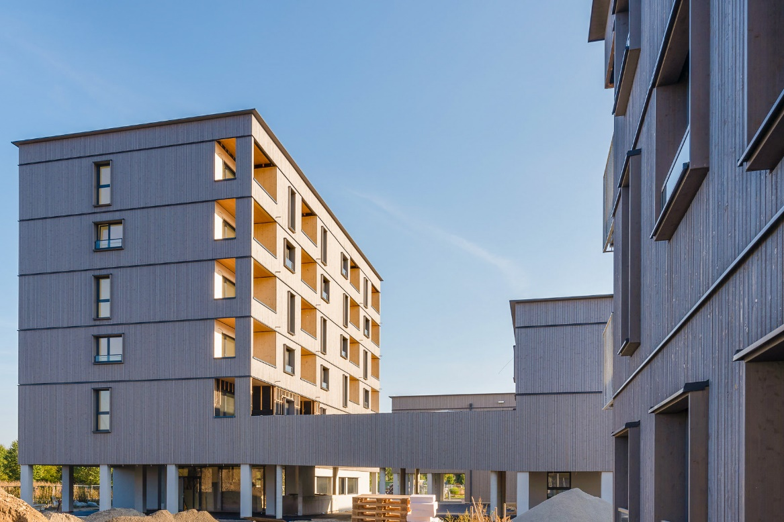
PROJECT AIM
UPWOOD forms a Strategic Partnership improve work-based learning VET, by developing and making available educational resources to address current and emerging occupational skills needs for energy efficient and innovative woodworking construction practices.
Project duration: October 2019 - March 2022
Duration: 30 months
©Pierer/WOHNBAUGRUPPE ENNSTAL

Slide 3
MAIN TARGET GROUPS
Construction sector employers
VET & WBL Apprentices in construction sector
Sector representatives and policy makers
VET & WBL providers
Associations, Networks & Social partners
VET authorities & career guidance bodies

Slide 4
PARTNERS
Holzcluster Steiermark
Leading cluster in Graz, developing and implementing projects along the Wood value chains, with special focus on timber construction.
EXELIA
Creative learning solutions company based in Athens, Greece specializing in vocational training with innovative methodologies.
LVT
Prestigious technical education school in Latvia, provides professional education programs, including construction and woodworking.
Universitat Politècnica de València
Public academic institution dedicated to researching and teaching in the field of construction technologies.
Woodpolis
Expert organization providing training and product development services for Wood construction, located in Finland.

Slide 5
3rd PROJECT MEETING
The 3rd UPWOOD meeting was initially planned to be held in Liepaja, Latvia. However due to COVID-19 it was organized virtually on 17th November 2020.
During the meeting the status of the UPWOOD learning materials was discussed. The vision and concept of the Trainer Handbook, its preliminary structure and content was also presented. Additionally, the partners discussed the plan for O3 - which aims to develop the training scenarios.
UPWOOD 3rd project meeting (Virtual)
17 November 2020
It was a pleasure to have a presentation from Mr. Intars Dicmanis, manager of MiTek Baltic, to share his experience on Production of the Wooden Trusses an Overview of the Baltic States Region.

Slide 6
ACTIVITY PROGRESS
O2-T2 Creation of educational resources
The main task carried out by all the partners during this semester has focused on the development and completion of the Learning Units for the UPWOOD Open Education Resources. All partners have worked hard to carry out the learning units based on the learning outcomes in accordance with the UPWOOD objectives.
The UPWOOD curriculum consists of four learning units created following the criteria set up by the European ECVET network. Each learning unit consists of different lessons.
Each learning unit consists of a compendium of:
Lecture notes
Presentation slides
Assessment materials such us FAQs, multiple choice question and case studies.

Slide 7
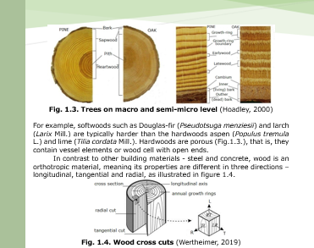
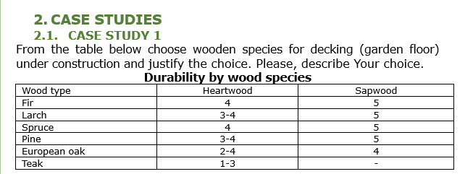
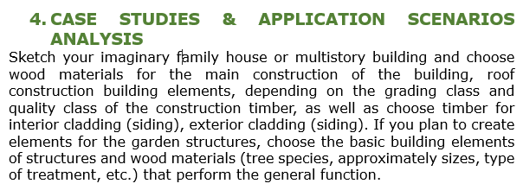
ACTIVITY PROGRESS
Wood properties, its limitations and wood construction physics.
Availability and environmental friendliness of wood as building material.
Possibilities of improving the properties of the wood and wood protection, durability.
O2-T2 Creation of educational resources
LU1: Qualities of wood and its various applications in construction
Lecture notes example
PPT Slides Example
Training & assessment material example

Slide 8
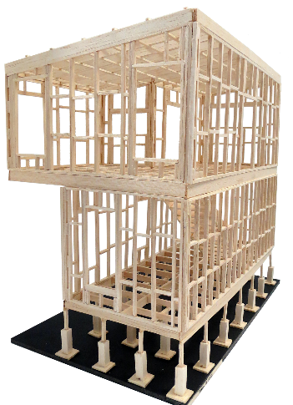
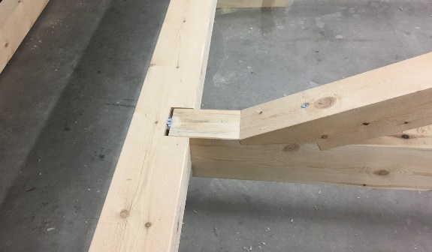
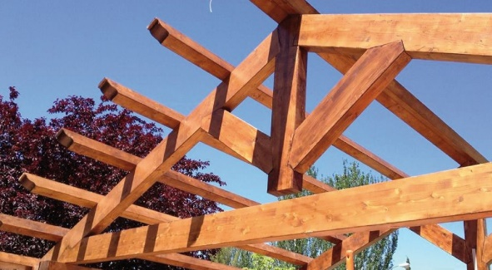
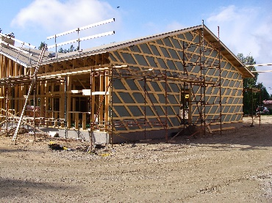
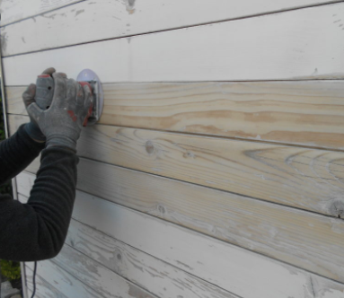
ACTIVITY PROGRESS
O2-T2 Creation of educational resources
LU2: Timber construction, renovation and deconstruction
Performance and durability of wooden constructions
General instructions for the use of wood material
Guidelines on work with GLT and CLT
The use of construction products
Connectors and adhesives
Restoration, reconstruction and dismantling
Wooden trusses

Slide 9
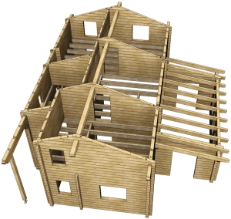
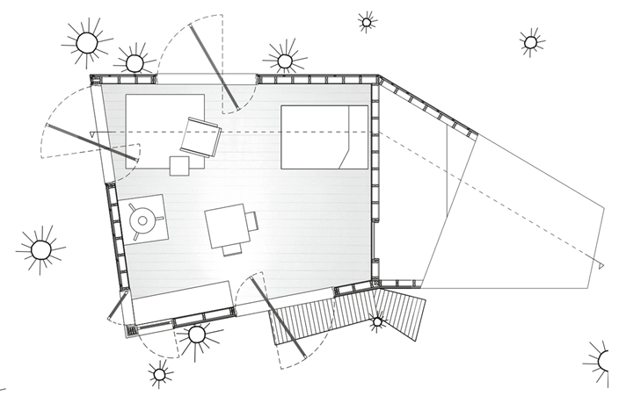
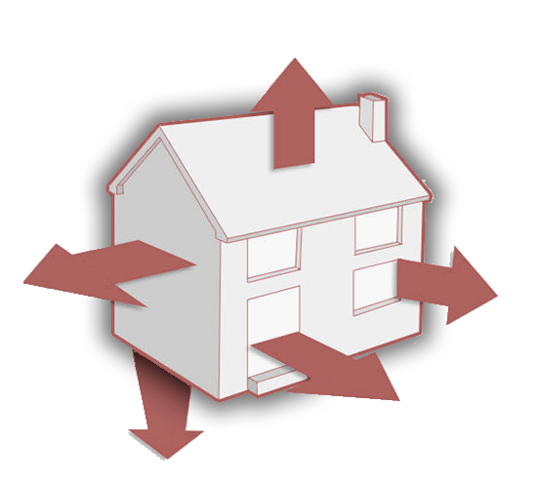
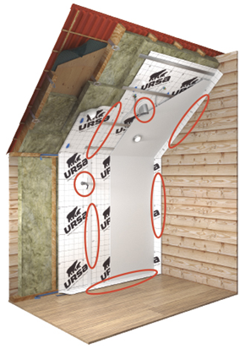
ACTIVITY PROGRESS
O2-T2 Creation of educational resources
O2-T2 Creation of educational resources
LU3: On-site wood construction assembling management
Work planning and Team Management
Ergonomics and labor safety
Transport and Storage guidelines
Architectural design
Short Vapor Barrier
Fire safety of timber buildings
Thermal insulation materials

Slide 10
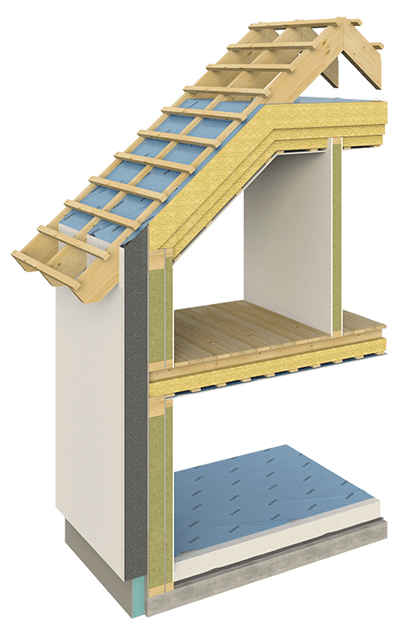
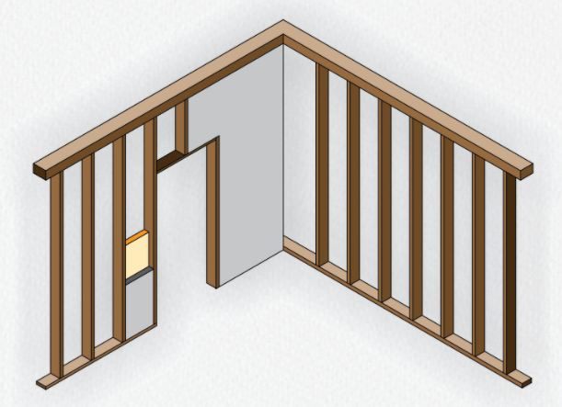
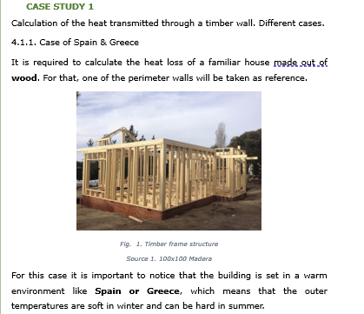
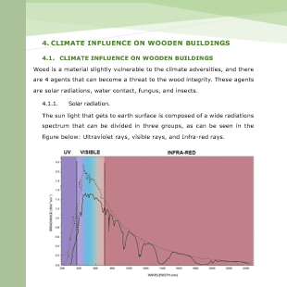
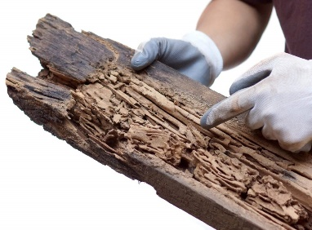
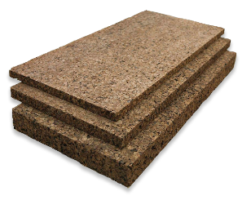
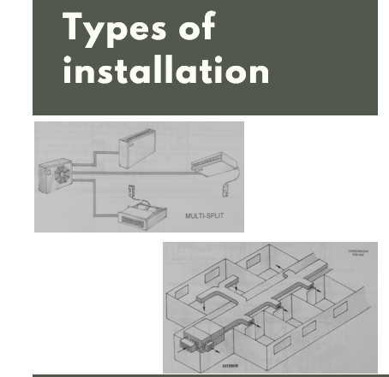
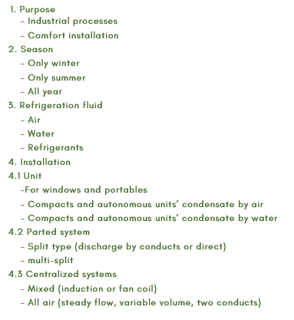
ACTIVITY PROGRESS
Energy-efficiency value of wood as a building material
Climate influence on wooden building.
Trainings for plumbing, drywall construction, sealing
Heating, ventilation, air conditioning, lighting, information and communications technologies systems
O2-T2 Creation of educational resources
LU4: Functionality and efficiency of wooden buildings
Training & assessment material example
PPT Slides Example
Lecture notes example
PPT Slides Example

Slide 11
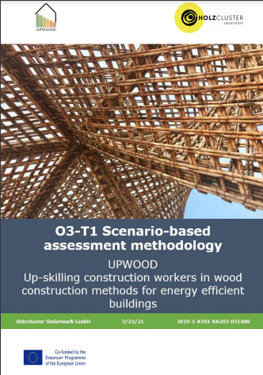
ACTIVITY PROGRESS
O3-T1 Scenario-based assessment methodology
Partners also began work on Intellectual Output 3 "UPWOOD Online training scenarios“, focusing on the development of the assessment methodology.
Game based learning or gamification represents an innovative training delivery method that takes advantage of the educational potential offered by games to boost work-based training procedures. This methodology talks about:
The educational value of training scenarios in construction work-based learning (WBL)
Trainers’ roles and responsibilities
Instructional design of UPWOOD training scenarios
Content specifications for training scenarios
Technical requirements & platform specifications

Slide 12
CONTACT US: upwood2019@gmail.com
Project coordinator: Austria
Mag. Visnja Koscak
Holzcluster Steiermark GmbH
T +043 (0) 316-58 78 50 - 220
Follow us:
www.upwoodproject.eu
Koscak@holzcluster-steiermark.at
DISCLAIMER: “The European Union support for the production of this publication does not constitute an endorsement of the content which reflects the views only of the authors, and the Commissions cannot be held responsible for any use which may be made of the information held therein.”

