Slide 1
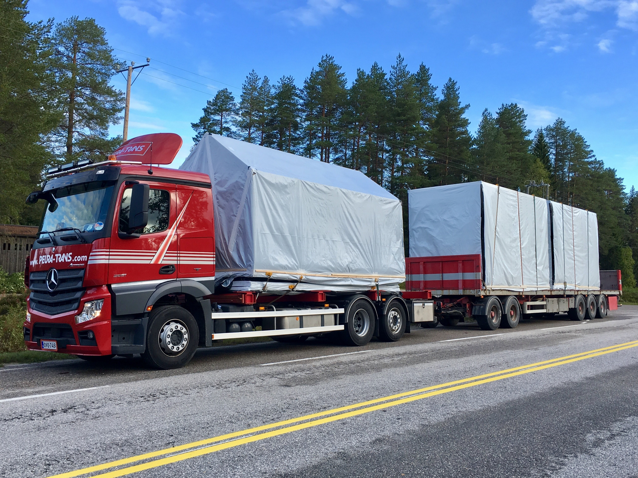
02-3/ LU3: ON-SITE CONSTRUCTION ASSEMBLING MANAGEMENT
GUIDELINES FOR TRANSPORTING AND STORING

Slide 2
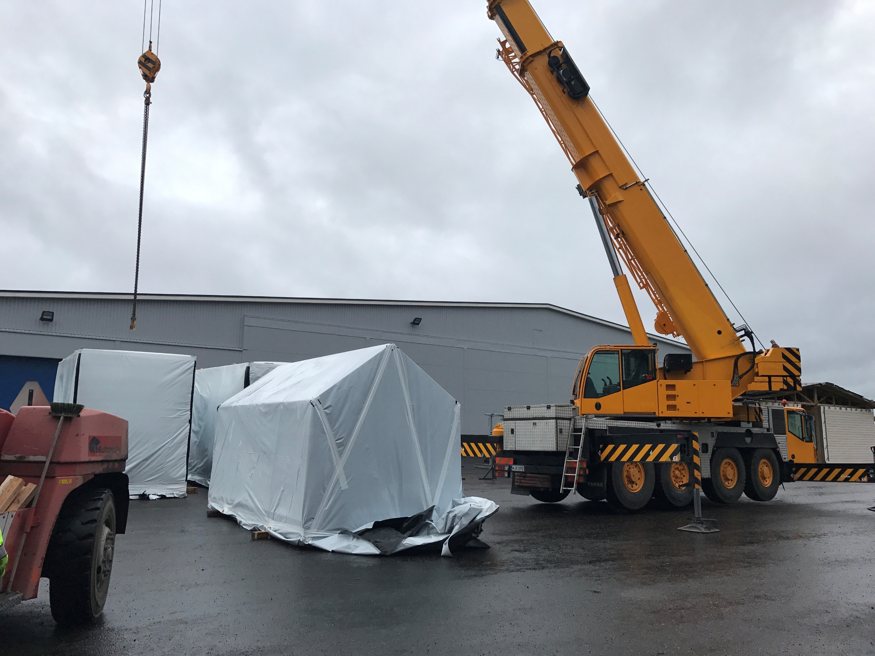
PRESENTATION OVERVIEW
Topics covered
Protection and local storage
Benefits
Frequently asked questions
GUIDELINES FOR TRANSPORTING AND STORING STRUCTURES

Slide 3
The protection of wood material during storage, transport and interim storage is important because the wood material tends to equilibrate with the surrounding conditions.
A poorly bonded or leaking rain cover moistens the surface wood, from where it is absorbed deeper into the wood material.
An oblique base causes a warped body that is no longer difficult to straighten.
It must also be remembered that the wood material is highly absorbent, so dirty or rusty water stains the surface of the wood material deeper.
Protection and local storage
3
GUIDELINES FOR TRANSPORTING AND STORING STRUCTURES

Slide 4
Benefits
PRODUCTIVITY
EFFICIENCY
A properly made transportation schedule and a delivery schedule tied to a construction schedule will increase productivity and reduce waiting times.
The right routines for storing and transporting preforms create efficiency and ensure quality is maintained.
ENVIRONMENT
COSTS
Properly stored preforms and properly prepared and executed transportation reduce material loss.
Pre-designed and properly dimensioned protection measures for different materials reduce construction costs.
GUIDELINES FOR TRANSPORTING AND STORING STRUCTURES

