Slide 1
Up-skilling construction workers in wood construction methods for energy efficient buildings
Upwood Project
4thSemester overview & progress April 2021 - September 2021

Slide 2
PROJECT AIM
MAIN TARGET GROUPS
UPWOOD forms a Strategic Partnership improve work-based learning VET, by developing and making available educational resources to address current and emerging occupational skills needs for energy efficient and innovative woodworking construction practices.
Project duration: October 2019 - March 2022
Duration: 30 months

Slide 3
MAIN OUTPUTS
O1 UPWOOD work-based learning outcomes
O3 Online training scenarios
Development, testing, and delivery of Online Training Scenarios on woodworking in construction, promoting the uptake of innovative and flexible practices in VET.
Analysis of current and future skills and knowledge needs leading to the development of learning outcomes.
O2 UPWOOD learning units & Open Educational Resources
O4 Framework for the integration of environmental components into construction sector WBL curricula and certification schemes
Development of pedagogical materials on innovative, energy efficient woodworking technologies, methods, and practical applications to be offered as Open Education Resources.
Involvement of key policy makers & stakeholders for the recognition of UPWOOD learning outcomes.

Slide 4
PARTNERS
Holzcluster Steiermark
Leading cluster in Graz, developing and implementing projects along the Wood value chains, with special focus on timber construction.
EXELIA
Creative learning solutions company based in Athens, Greece specializing in vocational training with innovative methodologies.
LVT
Prestigious technical education school in Latvia, provides professional education programs, including construction and woodworking.
Universitat Politècnica de València
Public academic institution dedicated to researching and teaching in the field of construction technologies.
Woodpolis
Expert organization providing training and product development services for Wood construction, located in Finland.

Slide 5
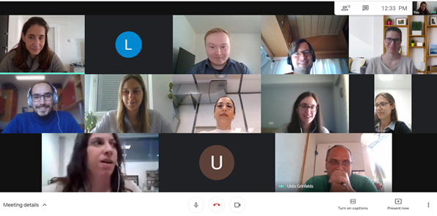
4th PROJECT MEETING
Date: 5th May 2021 (Initially planned to be held in Athens, Greece)
This meeting and this semester were mainly focused on Intellectual activity O3 which is about the development of the UPWOOD training scenarios. These scenarios will simulate real-life working situations in a construction, renovation or demolition in order to help learners understand new methods of wood construction in a more dynamic format. Several more follow-up meetings have been held throughout the semester to complete this task.
UPWOOD 4th project meeting (Virtual)
5 May 2021
Upcoming activities were discussed, such as the next information days that will take place during the following semester in Spain, Austria and Finland and the activities of the intellectual output O4 on the statement of support, among others.

Slide 6
ACTIVITY PROGRESS
O3-T2 Development of training scenarios
This semester, 4 practical scenarios were developed based on which the training game is being developed.
The topics are described below:
Training Scenario 1 on Qualities of wood as a building material, its applications and limitations
Training Scenario 2 on Selection of suitable wood material and supplies for facade renovation
A landowner intends to build a house of wood, so she turns to a builder. While the builder is experienced in construction, both he and the landowner have no experience with wood as a building material. Together they go to different experts to learn about wood properties and limitations.
Aki owns a log house built in the 1990s. The façade needs to be renovated as its exterior panels and surface paint has worn over time. Aki is familiar with working on wood, so he decided to buy supplies from a local timber store and renovate the façade by himself.
As the builder, will you be able to demonstrate to the landowner that you have a good knowledge of wood construction?
Will Aki have the proper knowledge to choose the right materials and carry out the renovation?

Slide 7
ACTIVITY PROGRESS
O3-T2 Development of training scenarios
This semester, 4 practical scenarios were developed based on which the training game is being developed.
The topics are described below:
Training Scenario 3 on Fire protection and occupational safety in wooden buildings
Training Scenario 4 on Functionality and efficiency of wooden buildings
There is an old apartment in need of a renovation. The owner, Mark, is aware of the poor insulation and wants to fix all the thermal bridges that can be improved in the property. The installations need to be updated too. The head of the works, Victoria, will help to choose the best options available.
Steve is a construction worker recently sent to a new project at the construction site where he is currently located. Steve is working together with a team of other construction workers. It is important to the foreman Tim that his co-workers gain insights into important tasks on site, so that they learn to work independently and behave responsibly.
Will you be able to help Steve to be up to the expectations of foreman Tim?
Will Victoria be able to help Mark choose the best options for the renovation?

Slide 8
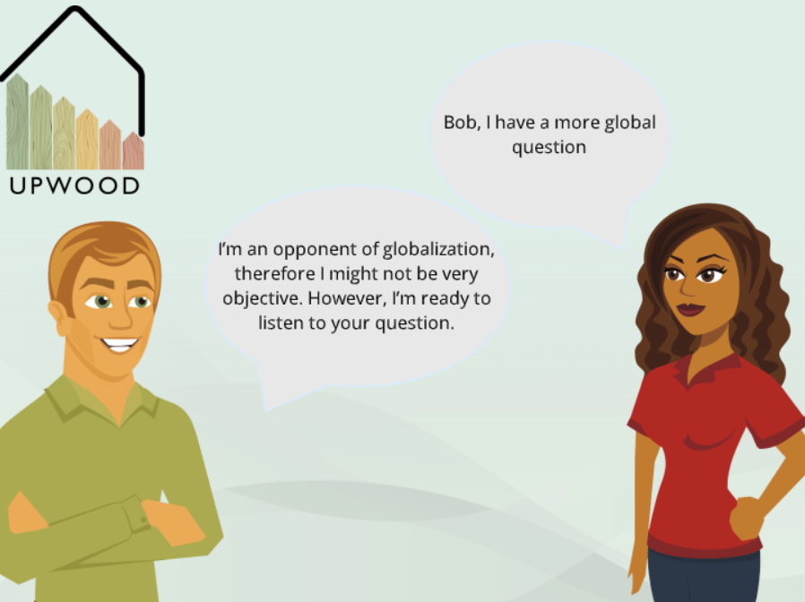
ACTIVITY PROGRESS
O3-T3 Selection & deployment of the UPWOOD online tool
The training game consisting of 4 separate branching scenarios will be developed in its online form using the software Articulate Storyline 2.
The main advantage of branching scenarios over linear narratives is that trainees can try different options and learn from both successful and unsuccessful choices. They will experience a story that will simulate real life by immersing them in a realistic context where they can witness their immediate impact in a consequence-free environment.
This tool allows to create interactive stories in the form of dialogue simulations, within a gaming environment, where the user assumes the role of the story protagonist.
This game is understood as goal-based structure.
Trainees will receive an assessment at the end of a game to determine if the learner has gained sufficient knowledge of each woodworking skill to have successfully completed the scenario.
The trainers will also be able to provide additional on-the-spot feedback and advice learners for further improvement.
Example of display of Articulate Storyline 2 platform

Slide 9
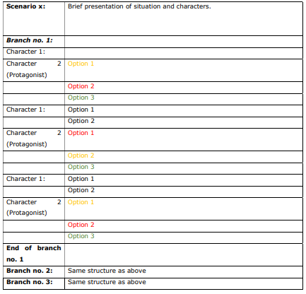
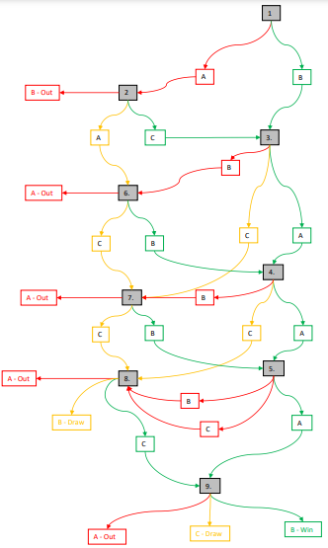
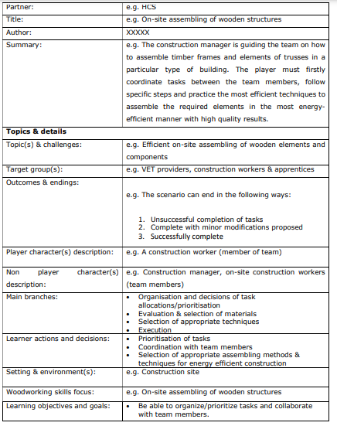
ACTIVITY PROGRESS
O3-T3 Selection & deployment of the UPWOOD online tool
The following steps were taken to develop the online tool.
Development of Branching scenarios to define the game’s storyline and set the final score based on the user’s decisions.
Content overview template to define the basic characteristics of each scenario.
O3-T2 Development of training scenarios based on Learning Units
Available from the next few months in in the following languages:

Slide 10
NEXT STEPS
Other activities planned to be carried out during the upcoming months:
O3: Online training scenarios
O4: Framework for the integration of environmental components into construction sector WBL
O3-T4 Mentors’ guide
O4-T1 Statement of support for the recognition of UPWOOD learning outcomes
Purpose: to guide construction workplace mentors on how to use the UPWOOD training scenarios in construction WBL.
Provide guidelines on preparing practical scenarios for distinct needs & training priorities.
In order to obtain mutual recognition of learning outcomes from UPWOOD stakeholders , contributing also to labour mobility and transparency of professional qualifications.
Activity O4
Associations and Social Partners
VET Providers
Construction sector Employers
Policy Makers

Slide 11
Contact us: Contact Name Partner Email address Partner’s phone number
Partner’s logo
Project coordinator:
DI Robert Pirker
Holzcluster Steiermark GmbH
T +43 (0) 316 - 58 78 50 - 215
Follow us:
www.upwoodproject.eu
Pirker@holzcluster-steiermark.at
DISCLAIMER: “The European Union support for the production of this publication does not constitute an endorsement of the content which reflects the views only of the authors, and the Commissions cannot be held responsible for any use which may be made of the information held therein.”

